Slide 1
Named Entity Recognition In Biomedical Corpus
Team Darwinisms :
Anant Bhavsar (17MA20002)
Saurabh Singh (17MT30018)
Bharat Chaudhary (17MA20009)

Slide 2
INTRODUCTION
Named-entity recognition (NER) is a subtask of information extraction that seeks to locate and classify named entity mentions in unstructured text into predefined categories such as the person ,names, organizations, locations, medical codes, time expressions, quantities, monetary values , percentages, etc. In our task we have tried to identify diseases and chemicals in Biomedical Corpuses.

Slide 3
MOTIVATION
Recognition of biomedical named entities in the textual literature is a highly challenging research topic with great interest, playing as the prerequisite for extracting huge amount of high-valued biomedical knowledge deposited in unstructured text and transforming them into well-structured formats. Long Short-Term Memory (LSTM) networks have recently been employed in various biomedical named entity recognition (NER) models with great success.

Slide 4
MODEL ARCHITECTURE
Our Model is based on Bidirectional LSTM CRF. We have trained model on 5 cases, 4 using pre trained word embeddings and one case without any pre trained word embedding on three different corpuses.

Slide 5
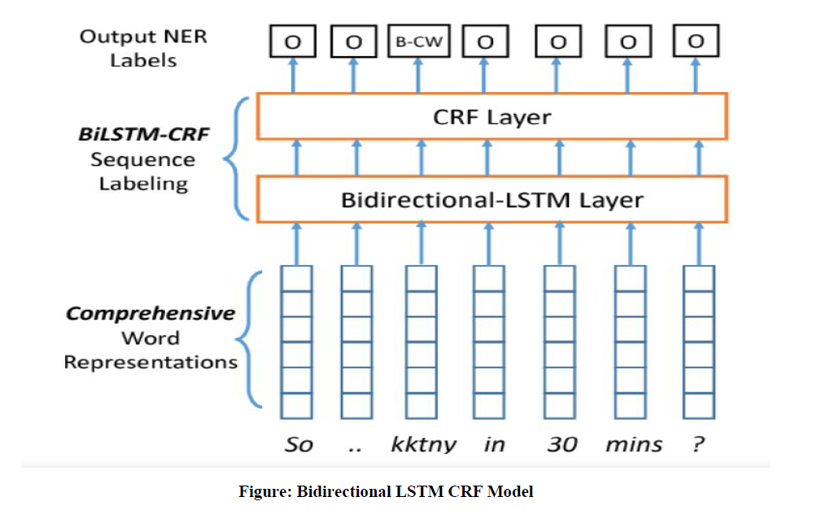

Slide 6
Corpuses and Embedding
Embeddings Used are –
Bioglove
Pubmed-w2v
Pubmed-and-PMC-w2v
wikipedia-pubmed-and-PMC
Corpuses used to train the model
BC5CDR-disease-IOB
BC5CDR-IOB
NCBI-disease-IOB

Slide 7
Example from Pubmed W2V on NCBI
[['Clustering', 'O'], ['of', 'O'], ['missense', 'O'],['mutations', 'O'], ['in', 'O'], ['the', 'O'],['ataxia', 'B-Disease'], ['-', 'I-Disease'],['telangiectasia', 'I-Disease'], ['gene', 'O'], ['in', 'O'], ['a', 'O'], ['sporadic', 'B-Disease'], ['T', 'I-Disease'], ['-', 'I-Disease'], ['cell', 'I-Disease'], ['leukaemia', 'I-Disease'], ['.', 'O']]
['O', 'O', 'O', 'O', 'O', 'O', 'B-Disease', 'I-Disease', 'I-Disease', 'O', 'O', 'O', 'O', 'O', 'O', 'O', 'O', 'O', 'PAD', 'PAD', 'PAD', 'PAD', 'PAD', 'PAD', 'PAD', 'PAD', 'PAD', 'PAD', 'PAD', 'PAD', 'PAD', 'PAD', 'PAD', 'PAD', 'PAD', 'PAD', 'PAD', 'PAD', 'PAD', 'PAD', 'PAD', 'PAD', 'PAD', 'PAD', 'PAD', 'PAD', 'PAD', 'PAD', 'PAD', 'PAD', 'PAD', 'PAD', 'PAD', 'PAD', 'PAD', 'PAD', 'PAD', 'PAD', 'PAD', 'PAD', 'PAD', 'PAD', 'PAD', 'PAD', 'PAD', 'PAD', 'PAD', 'PAD', 'PAD', 'PAD', 'PAD', 'PAD', 'PAD', 'PAD', 'PAD', 'PAD', 'PAD', 'PAD', 'PAD', 'PAD', 'PAD', 'PAD', 'PAD', 'PAD', 'PAD', 'PAD', 'PAD', 'PAD', 'PAD', 'PAD', 'PAD', 'PAD', 'PAD', 'PAD', 'PAD', 'PAD', 'PAD', 'PAD', 'PAD', 'PAD', 'PAD', 'PAD', 'PAD', 'PAD', 'PAD', 'PAD', 'PAD', 'PAD', 'PAD', 'PAD', 'PAD', 'PAD', 'PAD', 'PAD', 'PAD', 'PAD', 'PAD', 'PAD', 'PAD', 'PAD', 'PAD', 'PAD', 'PAD', 'PAD', 'PAD', 'PAD', 'PAD', 'PAD', 'PAD', 'PAD', 'PAD', 'PAD', 'PAD', 'PAD', 'PAD', 'PAD', 'PAD', 'PAD']

Slide 8
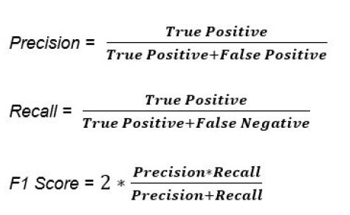
Evaluation Metrics
We have done error analysis by calculating Precision, Recall and F1 Score in both the cases exact and partial matches.

Slide 9
Results on NCBI-disease-IOB
Partial Match
Embedding | Precision | Recall | F1-Score
No pre-trained Embedding | 0.71 | 0.82 | 0.76
Bioglove | 0.71 | 0.74 | 0.72
Pubmed-w2v | 0.86 | 0.77 | 0.81
Pubmed-and-PMC-w2v | 0.81 | 0.78 | 0.80
wikipedia-Pubmed-and-PMC-w2v | 0.57 | 0.56 | 0.57

Slide 10
Exact Match
Embedding | Precision | Recall | F1-Score
No pre-trained Embedding | 0.69 | 0.74 | 0.71
Bioglove | 0.68 | 0.65 | 0.67
Pubmed-w2v | 0.85 | 0.71 | 0.78
Pubmed-and-PMC-w2v | 0.8 | 0.73 | 0.77
wikipedia-Pubmed-and-PMC-w2v | 0.49 | 0.40 | 0.44

Slide 11
Results for BC5CDR-disease-IOB
Partial Match
Embedding | Precision | Recall | F1-Score
No pre-trained Embedding | 0.47 | 0.51 | 0.49
Bioglove | 0.79 | 0.74 | 0.76
Pubmed-w2v | 0.82 | 0.73 | 0.77
Pubmed-and-PMC-w2v | 0.83 | 0.71 | 0.77
wikipedia-Pubmed-and-PMC-w2v | 0.62 | 0.49 | 0.55

Slide 12
Exact Match
Embedding | Precision | Recall | F1-Score
No pre-trained Embedding | 0.38 | 0.35 | 0.37
Bioglove | 0.78 | 0.68 | 0.73
Pubmed-w2v | 0.81 | 0.68 | 0.74
Pubmed-and-PMC-w2v | 0.82 | 0.65 | 0.73
wikipedia-Pubmed-and-PMC-w2v | 0.60 | 0.33 | 0.42

Slide 13
Results for BC5CDR-IOB(chem+disease)
Partial Match
Embedding | Precision | Recall | F1-Score
No pre-trained Embedding | 0.69 | 0.70 | 0.70
Bioglove | 0.82 | 0.71 | 0.76
Pubmed-w2v | 0.80 | 0.75 | 0.77
Pubmed-and-PMC-w2v | 0.87 | 0.65 | 0.75
wikipedia-Pubmed-and-PMC-w2v | 0.73 | 0.78 | 0.76

Slide 14
Exact Match
Embedding | Precision | Recall | F1-Score
No pre-trained Embedding | 0.68 | 0.65 | 0.66
Bioglove | 0.81 | 0.67 | 0.73
Pubmed-w2v | 0.79 | 0.72 | 0.75
Pubmed-and-PMC-w2v | 0.87 | 0.61 | 0.72
wikipedia-Pubmed-and-PMC-w2v | 0.72 | 0.74 | 0.73

Slide 15
Observations
1) NCBI-DISEASE-IOB
In this Corpus we are getting the best performance by using Pubmed-w2v and Pubmed-and-PMC-w2v and the model is performing the worst in the case of wikipedia-pubmed-and-PMC.Model is giving best results on using 10-20 epochs, 100 units of Bi-LSTM.

Slide 16
2) BC5CDR-DISEASE-IOB
In this Corpus we are getting the best performance by using Pubmed-w2v and Pubmed-and-PMC-w2v and the model is performing the worst in the case of No pre-trained word embeddings. Model is giving best results on using 40-50 epochs, 100 units of Bi-LSTM.

Slide 17
3) BC5CDR-IOB(chemicals+disease)
In this Corpus we are getting satisfactory performance(f1 score > 0.7) in all of the embeddings. Model is giving best results on using 20-30 epochs, 100 units of Bi-LSTM.

Slide 18
Conclusions
Overall in our analysis we have found that best performance is observed by using ‘Pubmed-w2v’ embedding in the case of all three of our corpuses.
This maybe due to the reason that this embedding is trained specifically on the biomedical corpus and was able to capture all the specific relations that exist between different entities in this domain that other embeddings were finding difficult to capture.

Slide 19
THANK YOU

